Slide 1
Electronics II
EEET-222
Lab #3
Introduction to Operation Amplifiers
(Pink and the Brain)
RCC-13

Slide 2
Lab #2 Objectives and Prelab
Objectives
  Examine the OpAmp working as a buffer.
  Understand how discrete transistors are used to boost the maximum current.
  Use an OpAmp to correct the cross-over distortion of a Class B complementary push-pull amplifier.
  Examine an OpAmp as a non-inverting and inverting amplifier.
Prelab
  If you have not seen “Pinky and the Brain”, google it.
  Go to web and determine the maximum current (sometime called the short circuit current) the 3904 and 3906 transistors. The transistors are like Pinky because they can provide lots of current. Large transistors can provide amps of current. However, like Pinky, they are not very smart. The 0.7V (V_{BE}) causes distortion.
  Go to web and determine the maximum current the op-amp. The op-amp is like Brain because it is very smart but cannot provide much current.
  Determine the gain for of circuits 4 and 5.
  Estimate the peak output swing for circuit 4 using your datasheets. Make sure the datasheet you find has a graph of supply voltage vs. output swing. Fairchild tends to have good datasheets.
RCC-13

Slide 3
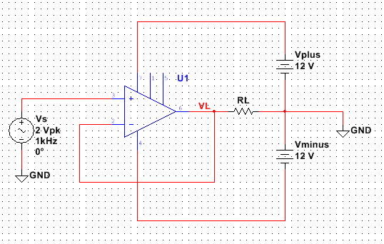
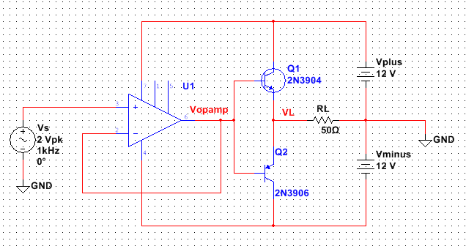
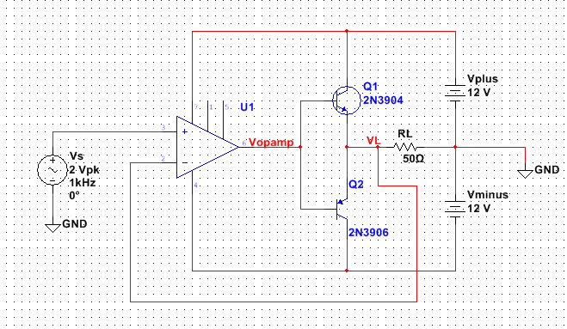
Circuits
Circuit 1
Circuit 2
RCC-13
Circuit 3

Slide 4
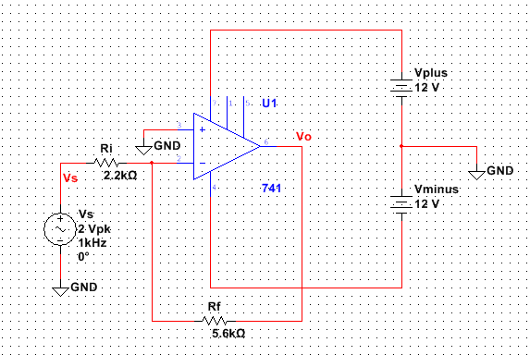
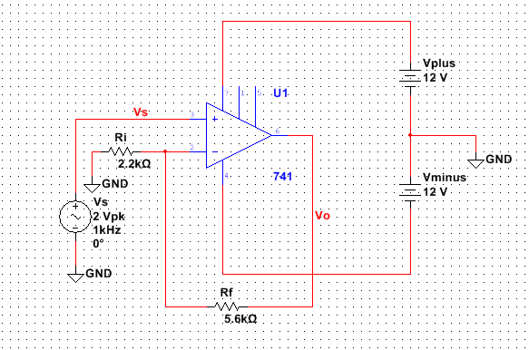
Circuits
Circuit 4
Circuit 5
RCC-13

Slide 5
Procedure
  Simulate circuits 1 using Multisim with a transient analysis and the following information:
    The op-amp is a 741 and found in the “analog” group in the “op amp” family.
    The source is an “AC_VOLTAGE” (not AC_POWER) found in the Sources group in the SIGNAL_VOLTAGE_SOURCES family.
    Adjust the values and display to match circuit 1.
    Change the output node name by double clicking on the wire above the output resistor. Enter VL or any preferred net name.
    Set RL to 1Kohm, simulate and display VL. Calculate the peak current and verify it is less than the typical maximum current of the 741 (25mA).
    Set RL to 50ohms and simulate. Calculate the peak current. The clipping starts when the peak current reaches the maximum op-amp current. The Brain is such a wimp!
    Get sign-off #1.
    Capture a screen shot of the output and copy it to Word.
  Simulate circuit 2 with a transient analysis and the following information:
    Add 2N3904 and 2N3906 transistors (Pinky) found in the transistor group.
    Change VL to Vopamp and name the node across RL VL again.
    Set RL to 50ohm, simulate and display Vopamp and VL. Calculate the peak current and verify it is less than the typical maximum current of the transistors (200mA).
    Capture a screen shot of the output and copy it to Word.
    Note: the transistors can provide more current but are stupid and distort the waveform. Pinky creates crossover distortion and lowers the output by 0.7V.
RCC-13

Slide 6
Procedure
  Simulate circuit 3 with a transient analysis and the following information:
    Move the opamp feedback to VL. Set RL to 50ohms and simulate.
    Note: Because the op-amp wants to keep its inputs the same, it pre-distorts its output adding the 0.7V needed to remove crossover distortion. The brain makes the output VL perfect.
    Get sign-off #2. Be prepared to discuss the differences between circuits 2 and 3.
    Capture a screen shot of the output and copy it to Word.
Build (not simulation) circuits 4 and 5 and measure Vs and Vout for each.
  Compare the gain with the prelab gain.
  Why is the gain negative in circuit 4? What does a negative gain mean?
  Make a printout of each circuit. Label both Vs and Vout.
  Calculate the gain on the printout. Work can be either hand written or typed, your choice.
  Note: If the output signal has “fuzz” on the peak add by-pass capacitors to the power rail like last week. Design rule: always add by-pass capacitors. In application, one is placed directly next to every power pin of every IC.
RCC-13

Slide 7
Report
Cover sheet with name, partner name, lab name and number.
Sign-off sheet.
Prelab work
  Minimum load resistance that can be driven by a 3904 and by the op-amp directly when the output is 10V.
  Data sheets from the web. Only include the pages you used. You do not need to print all the pages.
Include the printouts from circuits 1 through 5.
  Identified V_{OUT} on all print-outs.
  Show gain calculations on printouts 4 and 5. (hand written OR typed)
Write a 100 word summary. Include answers to the following questions.
  What advantage does Circuit #3 have over Circuit #1. Look up clipping. Think about the transistors and op-amp’s maximum current.
  What advantage does Circuit #3 have over Circuit #2. Look up cross over distortion. Think about the voltage required to turn on a transistor (V_{BE}).
  Does the inverting gain equation –R_{F}/R_{I} work? What does the minus sign mean?
  Does the non-inverting gain equation 1 + (R_{F}/R_{I}) work?
  Discuss experience finding data sheets.
RCC-13

Slide 8
Introduction to OpAmps
Lab 3 Sign-offs
Name _____________________________________ Circuit 1: RL = 1K and 50ohms
Circuit 3: Pinky and the Brain
Circuit 5: Non-inverting amplfiier
 |  | / /
Signature |  | Date
 |  | / /
Signature |  | Date
 |  | / /
Signature |  | Date
RCC-13

